Slide 1
Data Analysis Project
Name:- Restaurant Analysis & performance .
------------------------------------------------------------
Dataset:- Restaurant Data ,
------------------------------------
Business Domain :- Business Intelligence / Customer Insights,
----------------------------------------
Total records :- 9551.
Presented by :- Suraj Kapare

Slide 2
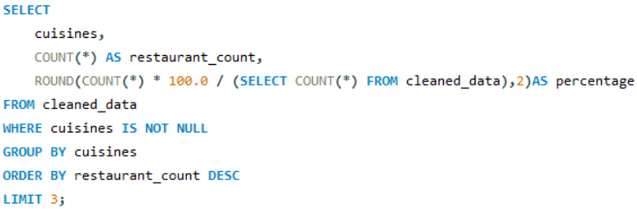

Task: Top Cuisines
Determine the top three most common cuisines in the dataset.
Calculate the percentage of restaurants that serve each of the top cuisines.
Result:-
Insights :- The top three cuisines represent the most popular cuisine choices among restaurants in the dataset, with their percentages showing their share of the total restaurant population .

Slide 3
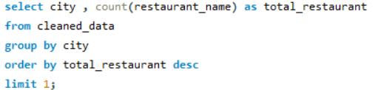
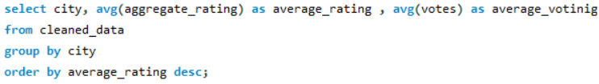

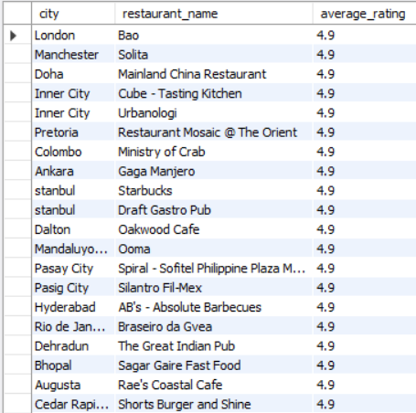
Task: City Analysis
Identify the city with the highest number of restaurants in the dataset.
Calculate the average rating for
restaurants in each city.
Result:-
Result:-
Insights :-
Here we can see the New delhi is the highest
number of restaurants city.
And this are the top average rating for restaurant
by city.

Slide 4
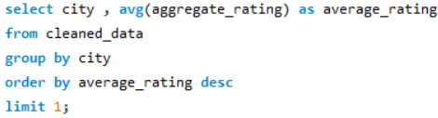

Determine the city with the highest
average rating.
Result:-
Insights :-
We can see the highest average rating is 4.9 for the inner city.

Slide 5
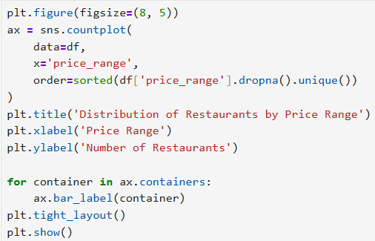
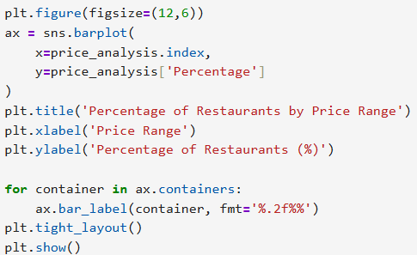
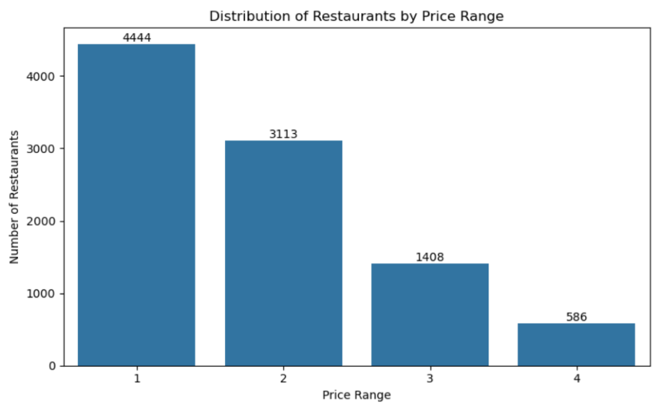
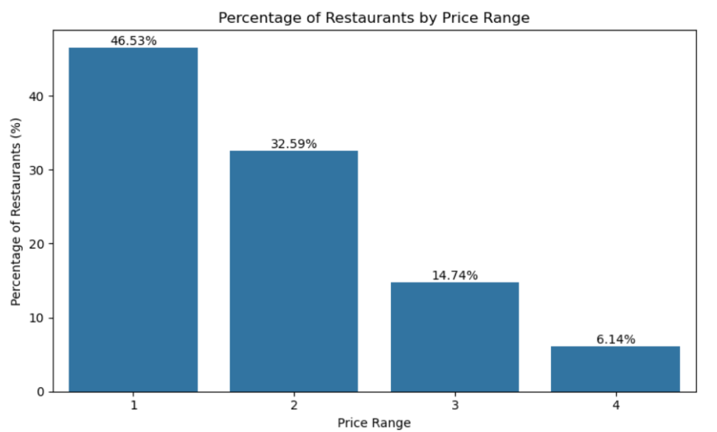
Task: Price Range Distribution
Create a histogram or bar chart to
visualize the distribution of price ranges
among the restaurants.
Calculate the percentage of restaurants
in each price range category.

Slide 6
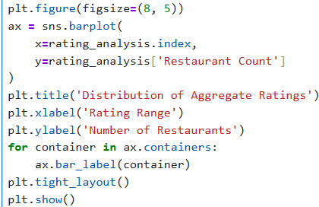
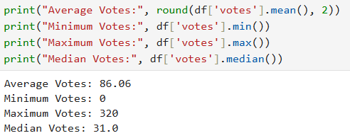
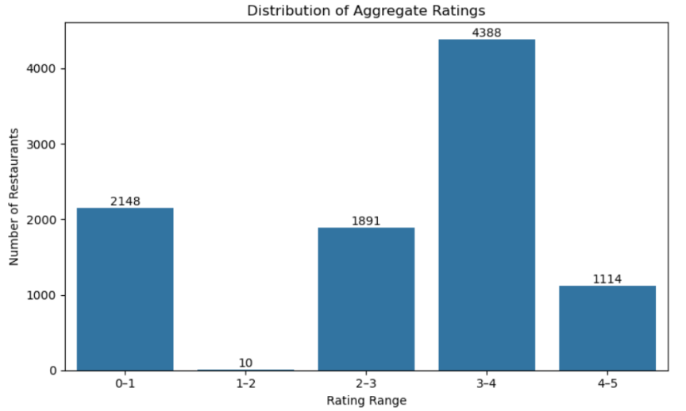
Task: Restaurant Ratings
Analyze the distribution of aggregate
ratings and determine the most common
rating range.
Calculate the average number of votes
received by restaurants.

Slide 7
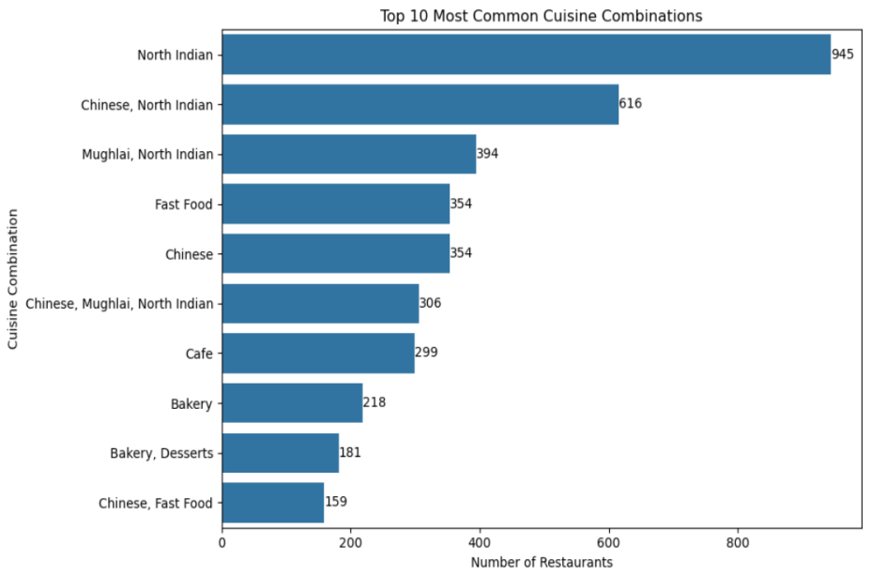
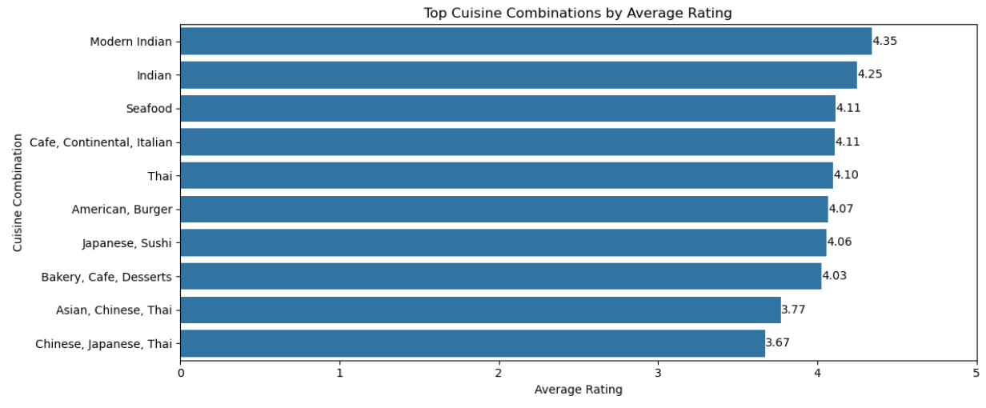
Task: Cuisine Combination
Identify the most common combinations of
cuisines in the dataset.
Determine if certain cuisine combinations
tend to have higher ratings.

Slide 8
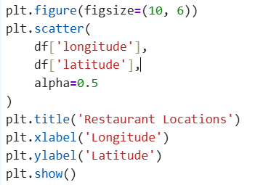
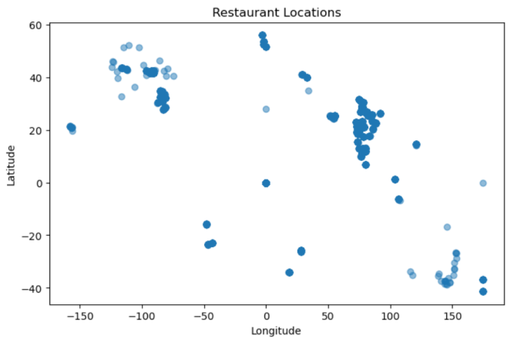
Task: Geographic Analysis
Plot the locations of restaurants on a map using longitude and latitude coordinates.
Result:-

Slide 9

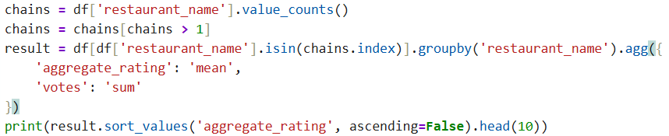
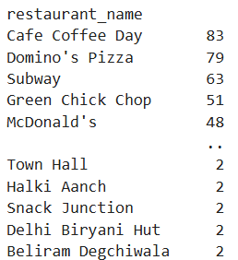
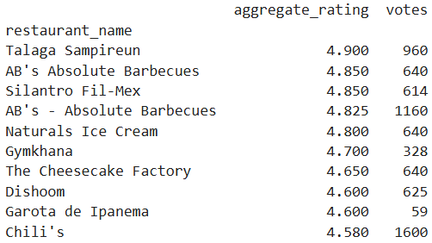
Task: Restaurant Chains
Identify if there are any restaurant chains
present in the dataset.
Analyze the ratings and popularity of
different restaurant chains.
Result:-
Result:-

Slide 10
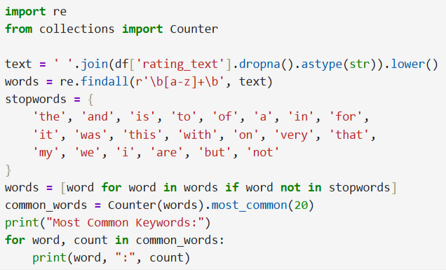
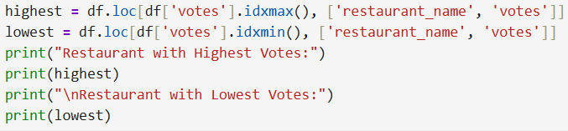
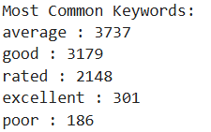
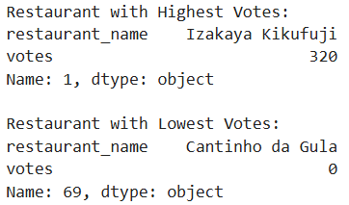
Task: Restaurant Reviews
Task: Votes Analysis
Analyze the text reviews to identify the most
common positive and negative keywords.
Identify the restaurants with the highest and
lowest number of votes.
Result:-
Result:-

Slide 11
Thank You.

